Slide 1

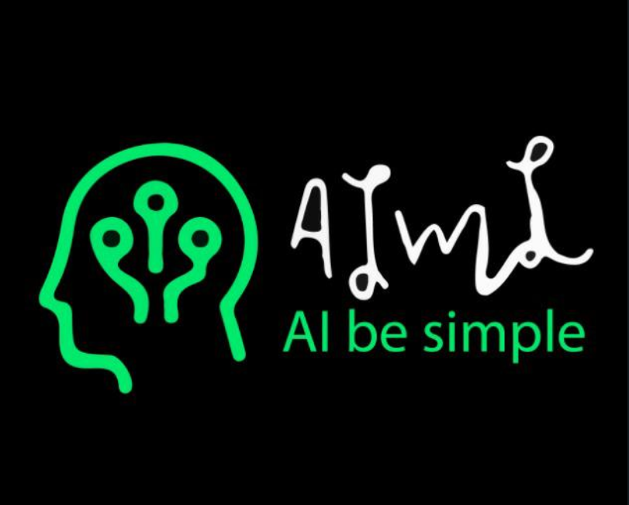
MACHINE LEARNING SESSION 1
AIML CLUB IIIT-NR

Slide 2
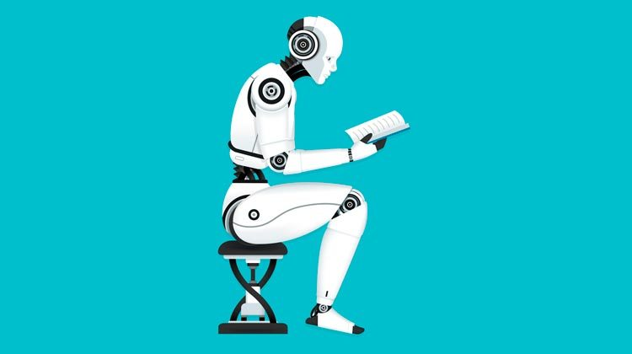
WHAT IS MACHINE LEARNING ?
Machine learning is an application of artificial intelligence (AI) that provides systems the ability to automatically learn and improve from experience without being explicitly programmed.

Slide 3
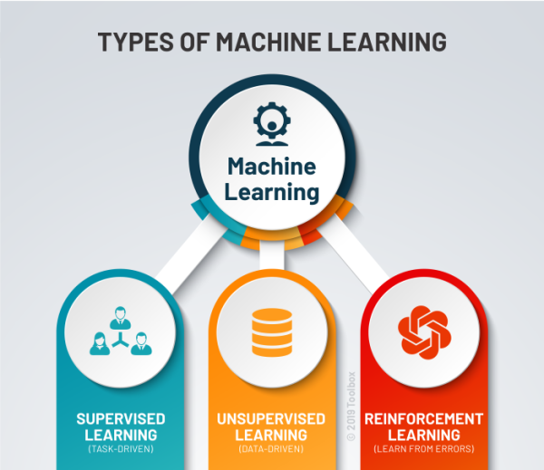
TYPES OF MACHINE LEARNING:

Slide 4
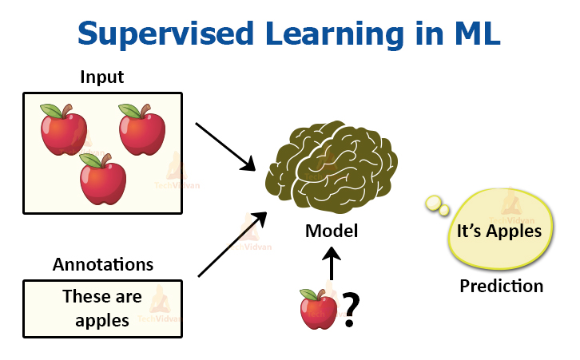
SUPERVISED LEARNING:

Slide 5
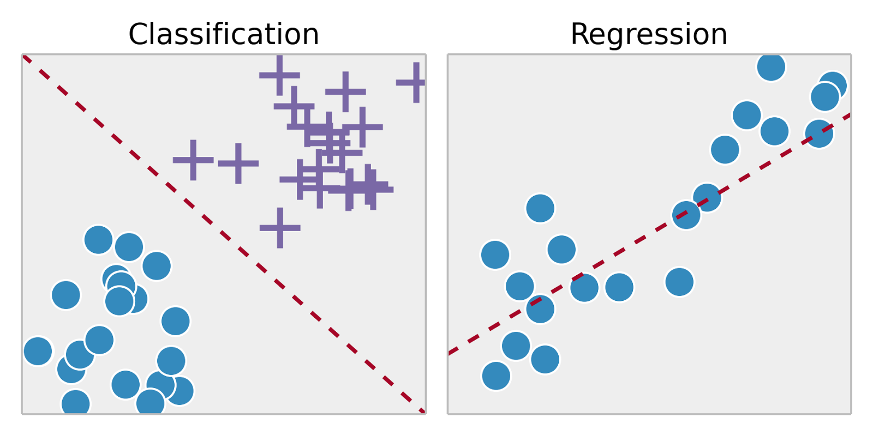
WHAT WE WILL STUDY IN SUPERVISED LEARNING:
Discrete value output Continuous value output

Slide 6
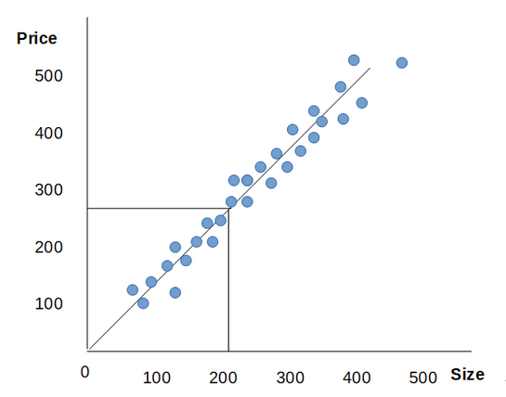
LINEAR REGRESSION WITH ONE VARIABLE:
We have to predict the best fit line : y = mx + b

Slide 7
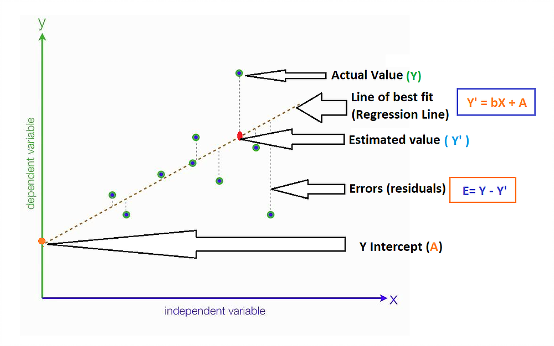
For one variable:

Slide 8
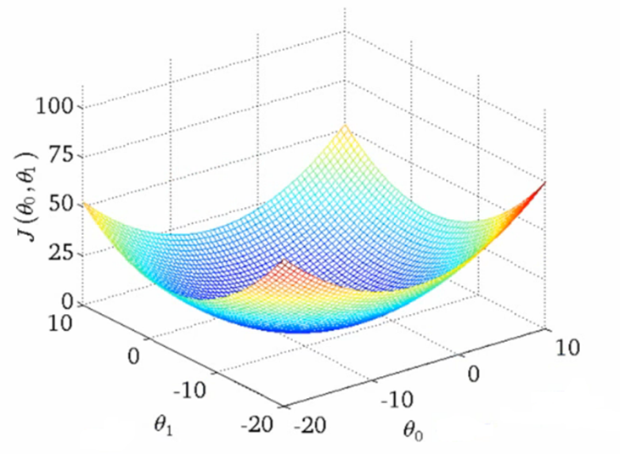
This is how graph will look like if we consider b also :

Slide 9
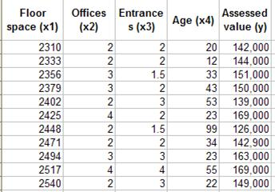
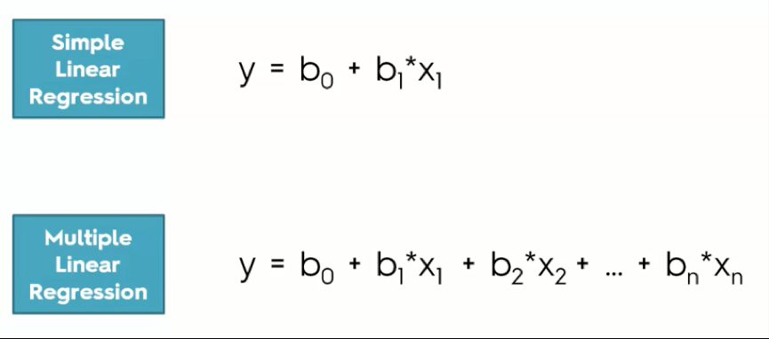
And for linear regression with more than one variable:

